Slide 1


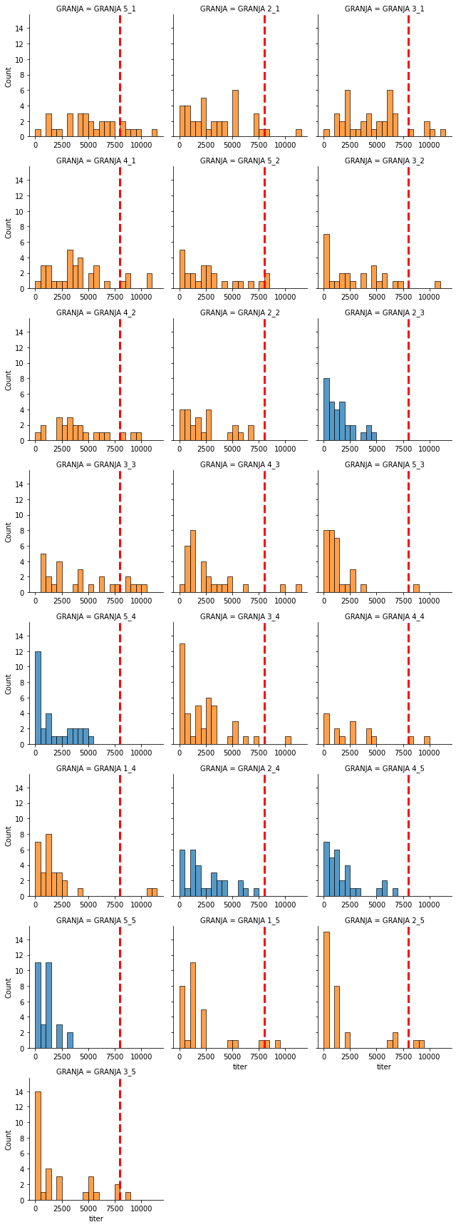
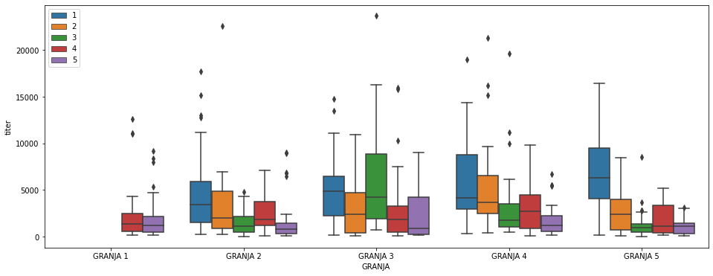
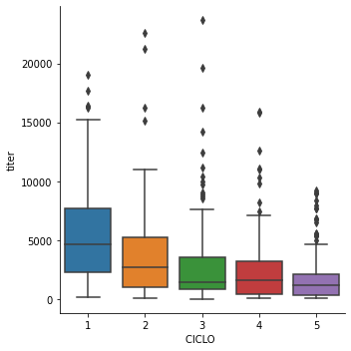
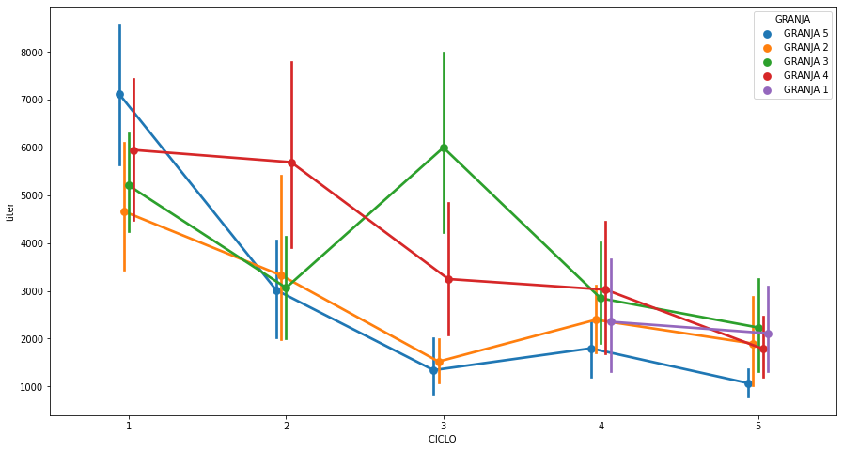
Serological monitoring as a tool to evidence ILT viral shedding reduction due to continuous vaccination with a rFP-gB vector vaccine in broilers
Carranza Claudia¹, Mathilde Lecoupeur², Higor Cotta², Jaime Sarabia³, Luiz Sesti⁴
Veterinary Services - Ceva Animal Health, Peru¹, Real World Evidence Unit², Veterinary Services - Ceva Corporate³, Veterinary Services – Ceva Latin America⁴
Introduction
During the first months of ILT outbreaks in Peru (2008) no biologic tool was available to prevent the disease, only specific biosecurity measures were implemented. However, biosecurity was not enough to control the spread of the disease in the Peruvian territory. The introduction of a vector fowl pox vaccine carrying the glycoprotein B gene of Infectious Laryngotracheitis virus (ILTV; rFP-gB) represented the first tool to effectively prevent and control the presentation of the disease. Though the reduction in the incidence of ILT cases and presentation of clinical signs was quite evident, no tools to serologically monitor vaccinated flocks were available.
Materials and Methods
In recent years, commercial kits that detect the serologic response of vector ILT vaccines were made available in the market. This work shows the results of a 1-year serologic monitoring at slaughter age, of 5 broiler farms (1.8M birds in total per production cycle) from a delimited geographic area with high challenge for ILT. All flocks were vaccinated (SQ) at day one with a rFP-gB vector vaccine. The IDVet commercial kit that detects specific antibodies against glycoprotein B of the ILTV was used.
For the statistical data analysis and data visualization, the Python programming language coupled with Numpy/Scipy modules were used.
Fig 1. Evident seroconversion in flocks vaccinated with rFP-gB at day one, and tested with IDVET ILT gB.
Fig. 3. Evolution of the serologic response in the field, from cycle one to cycle 5. Indicating shedding control of ILT.
Fig. 2. Linear plot showing the decrease in the titles, showing adecuate seroconversión (response to the vaccine) and control of the viral circulation in time in the field.
Results
Our results showed that the kit IDVET ILT gB can detect the response to the vaccine and the field virus infection in the flocks (fig. 1).
We observed a constant numerical decrease in the GMT and maximum titers obtained after every production cycle (fig. 2).
In the field, mortality decreased from 8% to 3% since the first cycle of usage of the rFP-gB vaccine.
Statistical difference in titers was observed in (fig. 3):
Cycle 1 vs Cycle 2 (p<0.05)
Cycle 4 vs Cycle 5 (p<0.05)
Cycle 1 vs Cycle 5 (p<0.05)
Fig. 4. Challenge plot: shows in Orange flocks that have been challenged with ILT virus after rFP-gB vaccination. Used parameters: 1 or more individual serologies over 8000 using IDVET ILT gB Elisa Kit.
Conclusion
These findings show the ability to serologically monitor the control of ILT with the use of a rFP-gB vector vaccine in broilers.
A constant decrease in the obtained titers is an indirect measure of ILTV shedding control.

